Slide 1
Scheduled Notebooks
with Papermill.
Recommended for you
@daily video_etl.ipynb

Slide 2
Matthew Seal
Speaker Details
Backend Engineer on the Big Data Platform Team
@ Netflix
Notes:
Who-am-I introduction

Slide 3
Notebooks Everywhere
Headline
Why?
Notes:
Or maybe “why not”? Setup that we’re going to try convincing you this is compelling.

Slide 4
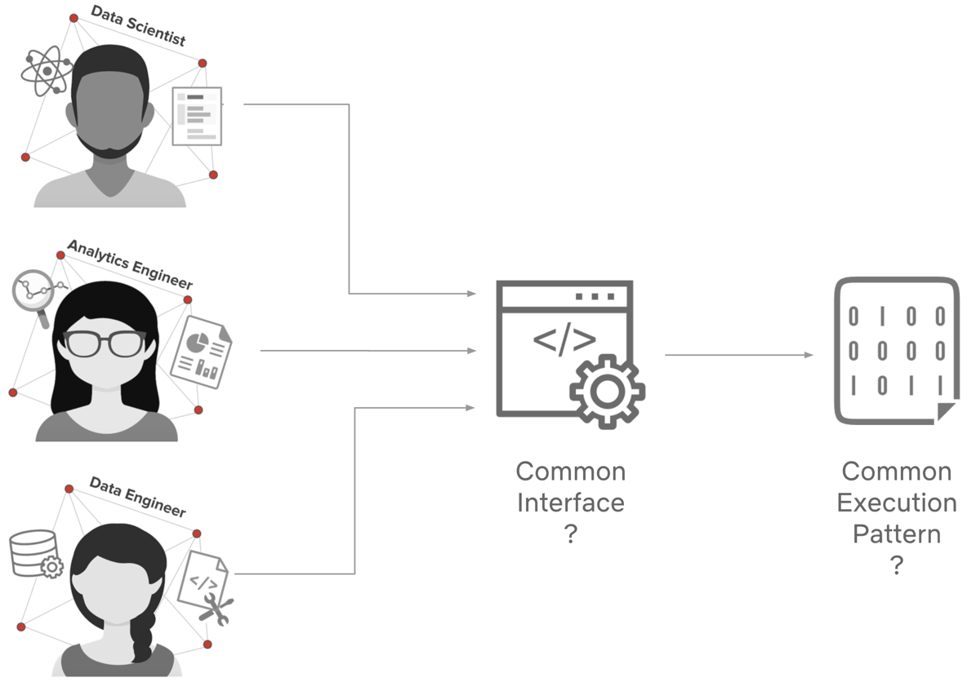
Our future data users.
Notes:
Talk about how we’re growing as an organization and the scope of users who benefit from access to our data is expanding. We needed to re-evaluate our tooling to meet this need

Slide 5
A few questions we had.
To look forward at future needs, we started by asking a few basic questions:
What interface will a data analyst use to chart a few combined queries into a business report?
How will a data engineer write code that a reliability engineer can help ensure runs every hour?
How will a machine learning developer encapsulate a model iteration their colleagues can reuse?

Slide 6
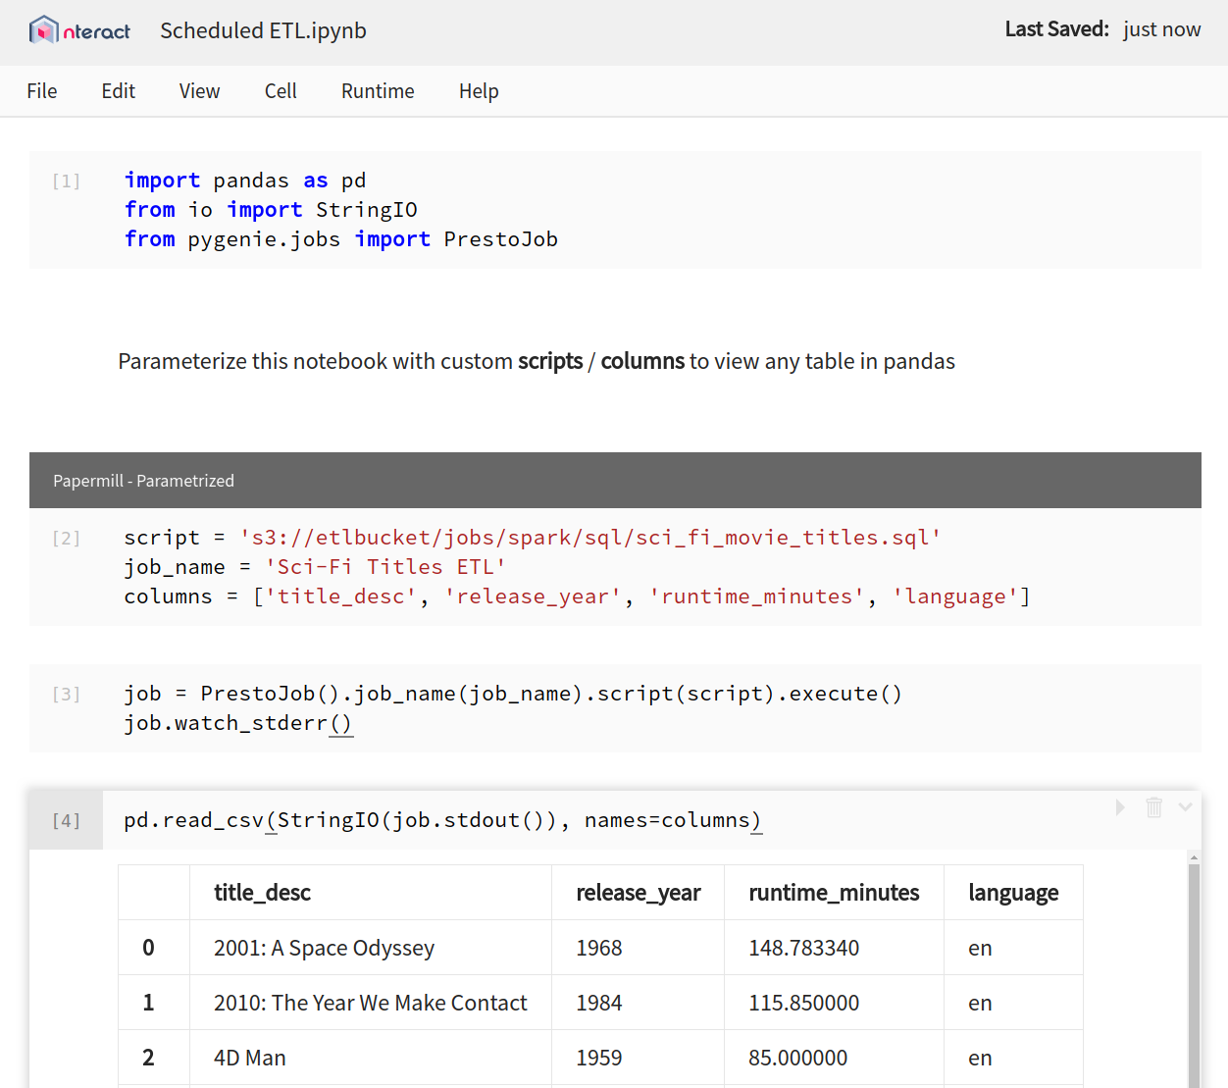
Notebooks.
Shareable
Easy to Read
Documentation with Code
Outputs as Reports
Familiar Interface
Multi-Language
Notes:
Highlight notebooks as a good interface for our future users. Denote that these attributes are all desired by the target audience
Reproducible, Collected in a single place, Accessible to anyone with a single url

Slide 7
A strategic bet!
We think notebooks will be the common interface for our users.
We’ve invested in notebook infrastructure for developing shareable analysis resulting in many thousands of user notebooks.
Oh, and we’re moving 10,000 jobs which
produce upwards of 150,000 queries a day to notebooks.
Notes:
We’re not crazy, we swear!

Slide 8
Flipping Notebook
Headline
Woes To Wins
Notes:
Before we talk about scheduling, let’s dive into some attributes of notebooks and where we need some better guarantees for the interface

Slide 9
Notebook Challenges
When did we change that notebook?
Notes:
Talk about what needs to be overcome to reach success

Slide 10
Fast development.
The Good
Quick iteration cycles
Recorded outputs
Easy to modify
The Bad
Lack of history
Easy to modify
The Ugly
Concurrent edits
Browser state
Notes:
There’s more of each, as with any tool. Be quick to get to more interesting topics

Slide 11
Production gaps to fill.
Things to preserve:
Results linked to code
Good visuals
Easy to share
Things to improve:
Not versioned
Mutable state
Templating
Notes:
Don’t spent too long here, just a quick note

Slide 12
Papermill
An nteract library
Notes:
Talk about nteract ecosystem for a second

Slide 13
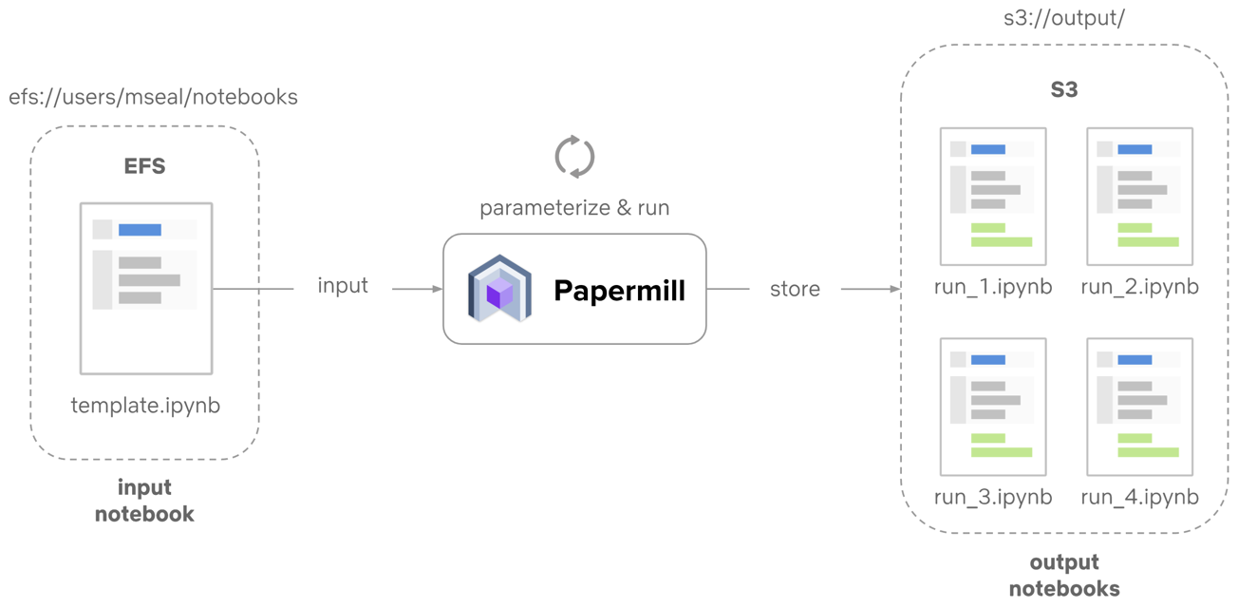
A simple library for executing notebooks.
Notes:
Explain that papermill lets you parameterize a notebook and save the run to a custom location.

Slide 14
Choose an output location.
Select a unique destination to get a running history of execution.
papermill input_notebook.ipynb outputs/{run_id}_out.ipynb
Produces:
outputs/
...
run_2018_08_22_out.ipynb
run_2018_08_23_out.ipynb
Notes:
These can be remote locations / services

Slide 15
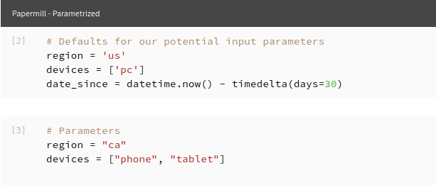
Add parameters.
Select a unique destination to get a running history of execution.
papermill input_notebook.ipynb outputs/{run_id}/output.ipynb
-p region ca -y ‘{“devices”:[“phone”,“tablet”]}’
Notes:
Any json inputs are valid

Slide 16
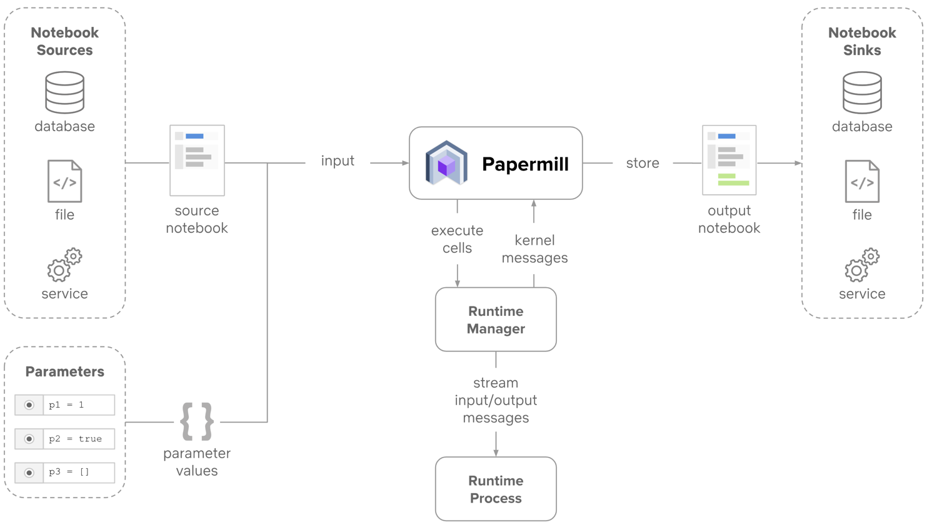
How it works.
Reads from a source
Injects a parameters cell to the JSON document
Launches a runtime manager which runs the notebook kernel and collects messages.
Outputs to a sink

Slide 17
How does this change the notebook experience?
It adds notebook isolation.
Immutable inputs
Immutable outputs
Parameterization of notebook runs
Configurable sourcing / sinking
Solves our problems for automated execution!
Notes:
Discuss how this makes notebooks operate like other functional operators and how it alleviates the problems with notebooks in production systems (for scheduling)

Slide 18
Notebooks on
Headline
Schedules
Notes:
Finally, the title of the talk. Apologize for spending long on some library :D

Slide 19
Picking a Scheduler
Most will do
Notes:
What scheduler we use isn’t super important to notebook execution.

Slide 20
Can it run a container?
Can it interpret cron strings?
If the answer is yes to these two questions, you have 90% of the basics you need to get started.
You’ll need to determine what’s important to your situation beyond this.
Notes:
Easy right? Well, there’s more nuance to what you want to accomplish, but the shared

Slide 21
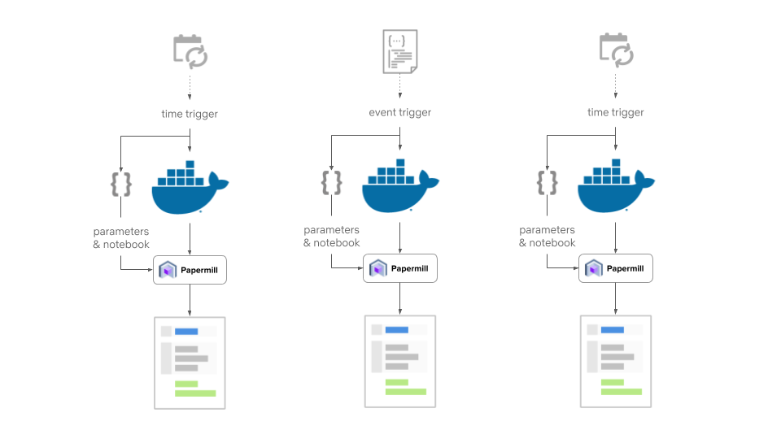
What will the tool need to do?
Notes:
Launch a container and call papermill parameterized to the run information. Needs kernels for notebooks to execute against and the libraries you want to provide to users.

Slide 22
Care about the secondary attributes you need.
Resource allocations
Event based scheduling
Execution isolation
Retry patterns
Metrics and analytics
Execution limits
Identity
DAGs
UI
...
Notes:
Lots of possible items to consider. Pick what you need for your business needs. Talk about the choice at Netflix.

Slide 23
Expressing Schedules
Simple is good
Notes:
If defining work is easy but expressing when and how to run that work is not we lose a key benefit.

Slide 24
We chose yaml as a human friendly format.
Our DSL layer lets users define their work in concise text files.
Trigger:
cron: ‘@daily’
Workflow:
id: video-device-etl
jobs:
- job:
id: user-video-stream-collect
type: NotebookJob
notebook:
input_path: https://commuter.netflix.com/nb/etl/uvsc.ipynb
run_date: ${WORKFLOW_ACTIVATE_DATE} # Parameter
- job: ...
Notes:
Walk through how these attributes map to the scheduled work. Talk about how more options are available.

Slide 25
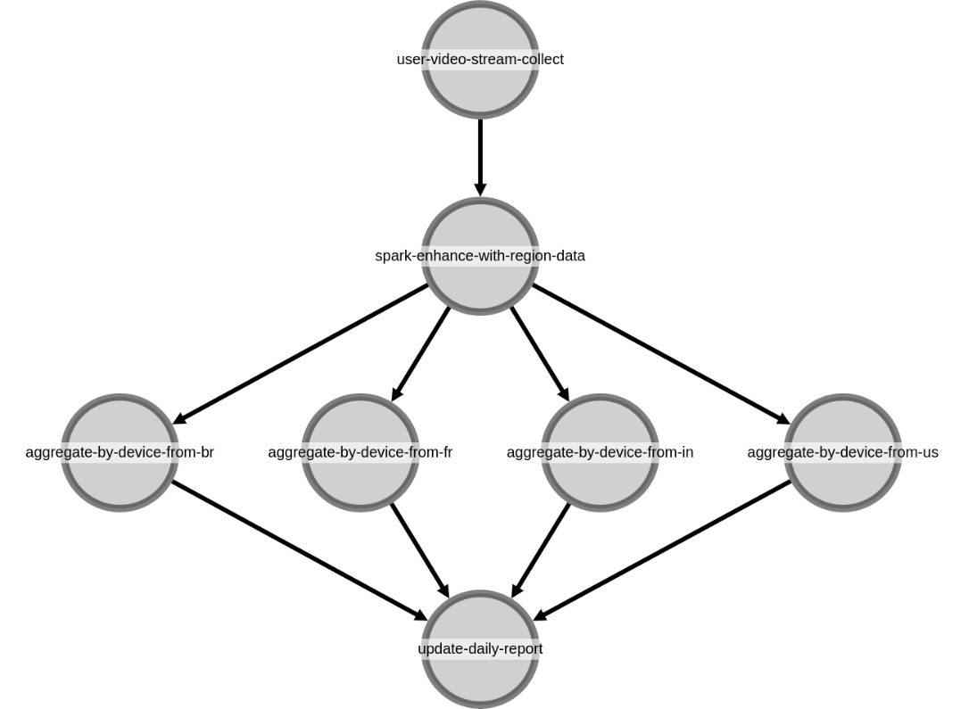
The platform makes these expressions real.
Notes:
Talk about how we can translate the yaml file to a scheduled graph of notebooks. Explain what a DAG is.

Slide 26
Diagnosing with
Headline
Outputs
Notes:
Connecting the value of notebooks back to the larger problem space.

Slide 27
Failed Notebooks
A better way to review outcomes

Slide 28
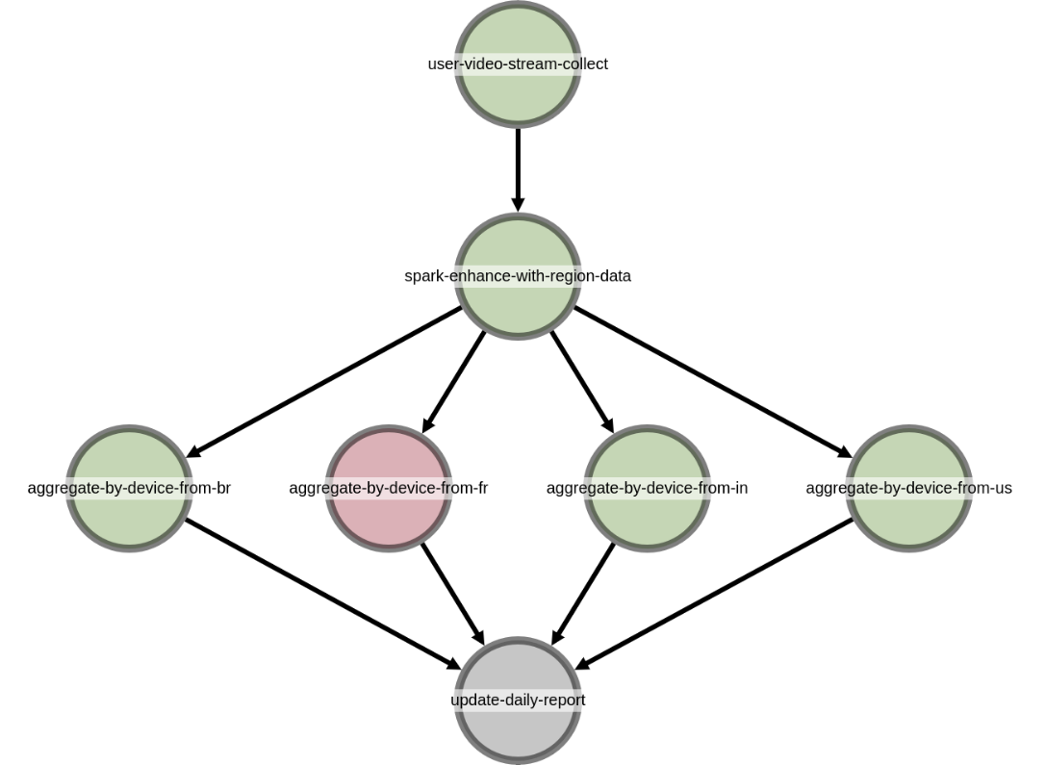
How we diagnose and fix failures is different now.
Notes:
Notebooks change how we debug this diagram. Our input interface is also our debug interface.

Slide 29
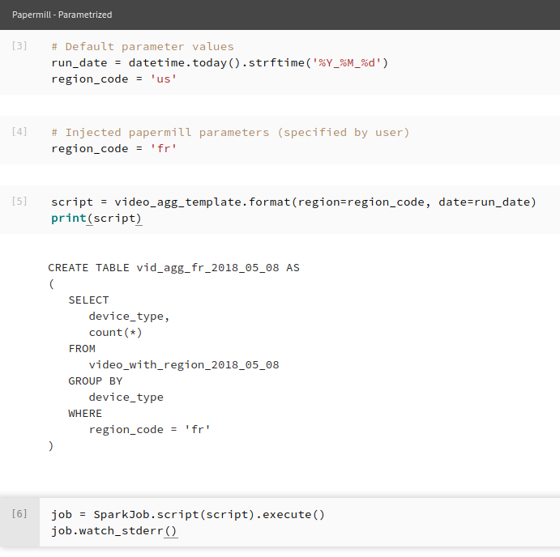
Failed outputs are useful.
Output notebooks are the place to look for failures. They have:
Stack traces
Re-runnable code
Execution logs
Same interface as input
Notes:
Here’s where notebooks shine for us. Simplify the evaluation process of what occurred.

Slide 30
Find the issue.
Test the fix.
Update the notebook.
Notes:
If you run your notebook on a notebook server against the same image, you can fix issues without needing to mock the execution environment or code.
More self-service friendly.

Slide 31
How notebooks
Headline
Integrate

Slide 32
Notebooks Are Not Libraries
Don’t treat them like a library
Notes:
When not followed, this is where a lot of notebooks leave the realm of shareable and enter the realm of one-offs

Slide 33
Notebooks are good integration tools.
Notebooks are good at connecting pieces of technology and building a result or taking an action with that technology.
They’re unreliable when complex and when they having a high branching factor.
Notes:
When not followed, this is where a lot of notebooks leave the realm of shareable and enter the realm of one-offs

Slide 34
Some development guidelines.
Keep a low branching factor
Short and simple is better
Keep to one primary outcome
Leave library functions in libraries
Move complexity to libraries
Notes:
These are just guidelines, we violate them all the time. But like coding conventions they set a rule of thumb which lends themselves to better outcomes.

Slide 35
Tests via papermill
Integration tests through scheduler DSL

Slide 36
An integration notebook is easy to test.
If our notebook is mostly linear, papermill commands proves we can execute the integration successfully.
papermill s3://commuter/etl/input_notebook_to_test.ipynb
s3://commuter/tests/runs/{run_id}/etl_test_output.ipynb
-p region luna -p run_date 2018_08_23 -y ‘{“debug”:true}’
Notes:
Or use the python API instead of the CLI.

Slide 37
Better tests with a scheduler.
Workflow:
id: integrations.video-elt-notebook-test
jobs:
- job:
id: video-etl-runner
type: SparkNotebook
debug: true
spark:
app_args:
- run_date: ${WORKFLOW_ACTIVATE_DATE}
- region: luna
script: s3://etl/scripts/spark/video_agg.py
Notes:
We can further test that the notebook executes in the scheduler environment as it would in production. We can test that the scheduler parameters map correctly. And we can chain notebook executions when the notebook you’re testing does not denote success when no errors occur.

Slide 38
Notebooks
Headline
At Netflix

Slide 39
We’re committing
And still exploring

Slide 40
Aspects we’re working on.
We’re not done, but we’re making headway. Here’s a few areas we’re still hoping to innovate on:
Better notebook sharing integration
Better interfaces (always)
Reviewing notebook diffs in git
Integrating with more notebook technologies
Notes:
Or use the python API instead of the CLI.

Slide 41
We hope you enjoyed the session
Thanks
Notes:
Mention tech blog and following talks

Slide 42
Questions?
Come find us at our booth!
Notes:
Try to leave at least 7 minutes here

